Slide 1

VOWELS /ˈvaʊəlz/

Slide 2
Introduction :
English Vowels – 5
a,e,i,o,u
Vowel sounds – 20
Single Vowels- Monophthongs - 12
Diphthongs - 8

Slide 3
Single Vowels
Short
a - /a/- /ʌ/ /æ/ /ə/
e - /e/- /e/
i - /i/- /I/
o - /o/- /ɒ/
u - /u/- /ʊ/
Long
/ ɑ: / / ɜ:/
/ i:/
/ ɔ:/
/ u:/

Slide 4
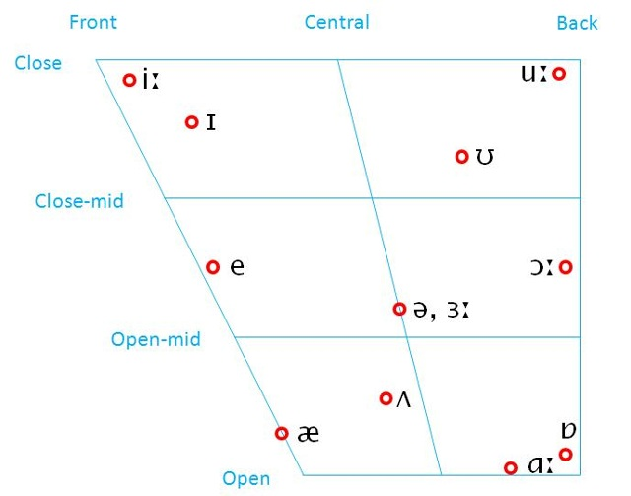
Characteristics:
Mouth open or close or partially open
Position of tongue- front, central, back
Shape of lips:
Rounded or
unrounded

Slide 5
Vowels
/ʌ/
open, central, unrounded
Fun /fʌn/
Love /lʌv/
Money /ˈmʌni/
/ ɑ: /
open, back, unrounded
Fast /fɑːst/
Car /kɑː/
Hard /hɑːd/

Slide 6
Vowels
/ə/
Mid, Central, unrounded
Alive /əˈlʌɪv/
Again /əˈɡeɪn/
Mother /ˈmʌðə/
/ ɜ:/
Mid, Central, unrounded
Nurse /nəːs/
Heard /həːd/
Third /θəːd/

Slide 7
Vowels
/I/
close, central, unrounded
Fill /fɪl/
Hip /hɪp/
Ship /ʃɪp/
/ i:/
close, central, unrounded
Feel /fiːl/
Heap /hiːp/
Sheep /ʃiːp/

Slide 8
Vowels
/ɒ/
open, back, rounded
Rob /rɒb/
Top /tɒp/
Watch /wɒtʃ/
/ ɔ:/
mid, back, rounded
Talk /tɔːk/
Law /lɔː/
Yawn /jɔːn/

Slide 9
Vowels
/ʊ/
Close, central, rounded
Put /pʊt/
Look /lʊk/
Should /ʃʊd/
/ u:/
Close, back, rounded
Few /fjuː/
Boot /buːt/
Lose /luːz/

Slide 10
Vowels
/æ/
open, front, unrounded
Cat /k æ t/
Hand /h æd/
Nap /n æ p/
/e/
mid, front, unrounded
Went /w e n t/
Intend /ɪnˈtɛnd/
Send /sɛnd/

